Slide 1
Gun Violence - Team 4
Team members:
Snigdha Reddy Pulim
Patrick Wright
Tarek Mourad
Vaishnavi Vadlamudi

Slide 2
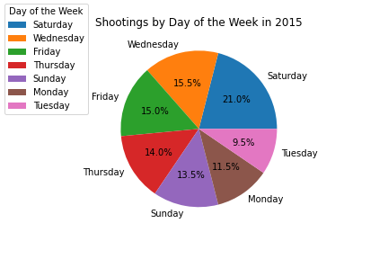
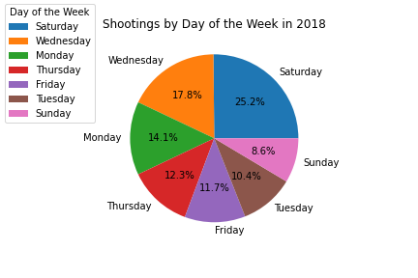
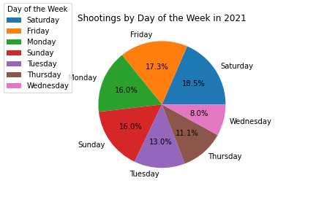
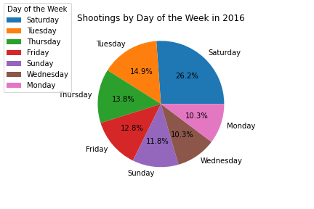
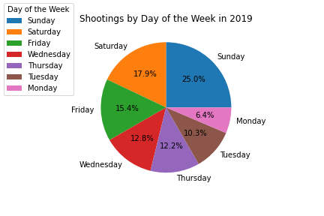
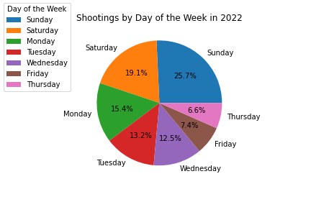
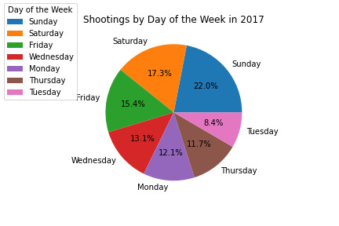
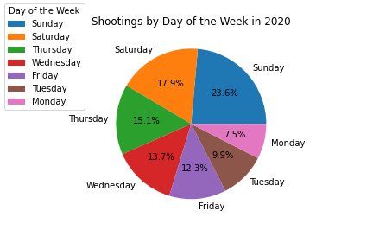
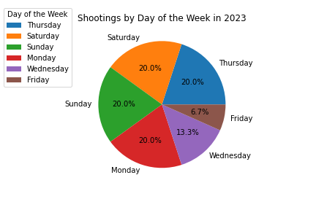
Victim Data of District 4 Shootings
The graphs to my left show the data for days of the week that shootings occurred within District 4 from 2015 - 2023.

Slide 3
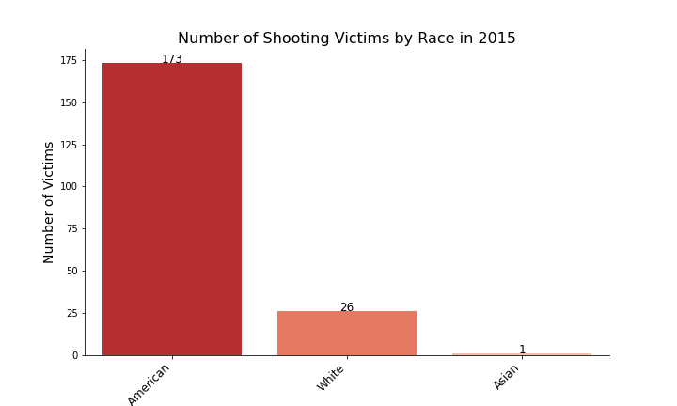
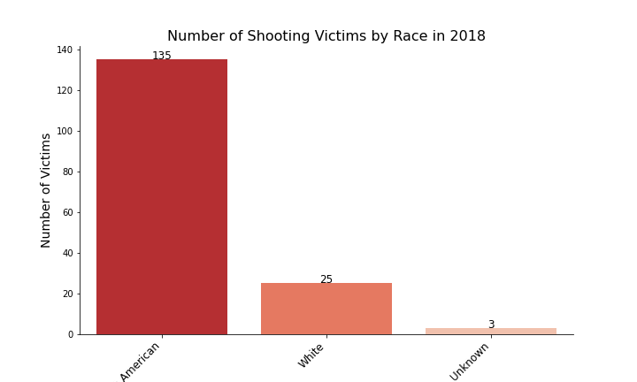
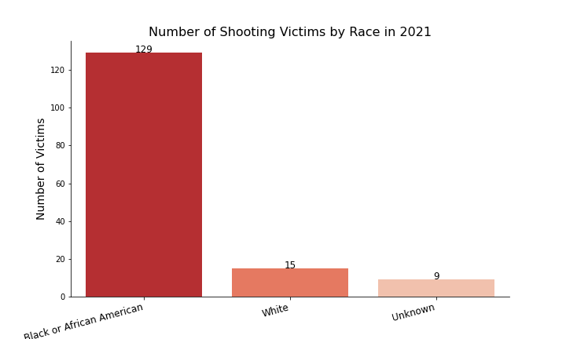
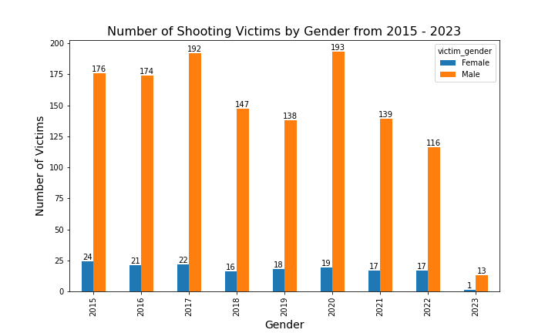
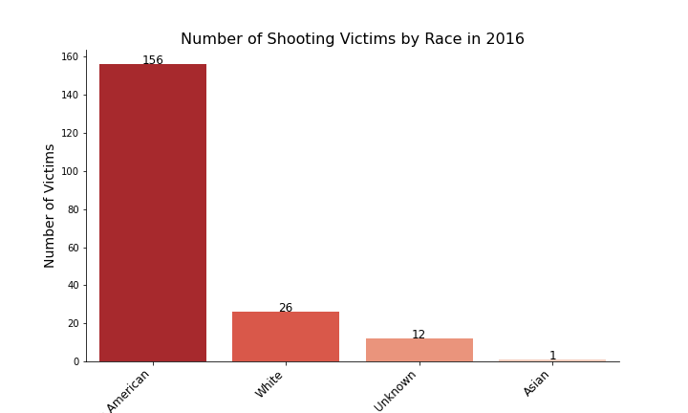

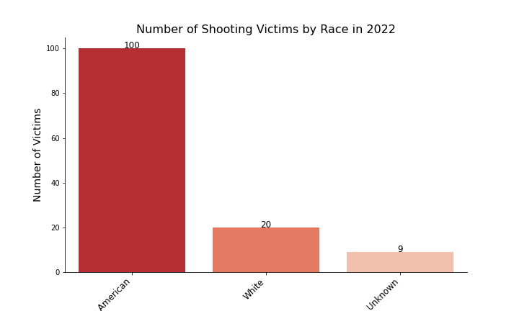
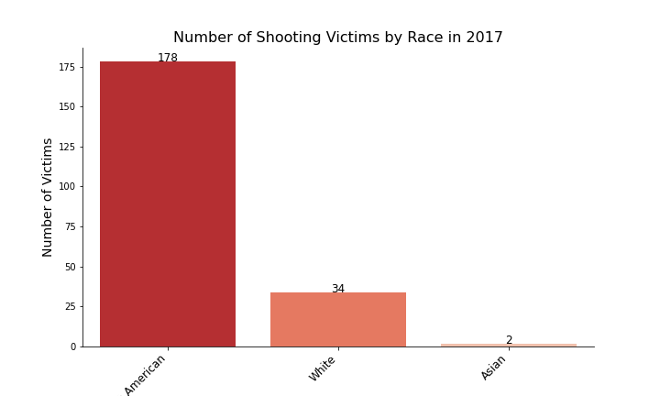

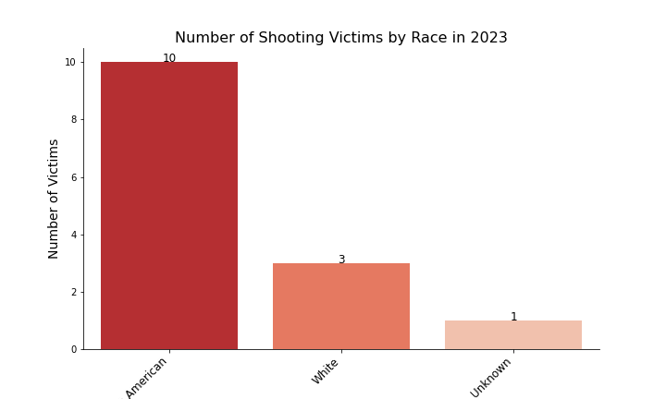
Shootings by Race and Gender in District 4
These graphs to the left show shootings by race from 2015 - 2023 in District 4. The graph above shows shootings based on gender using the same data.

Slide 4
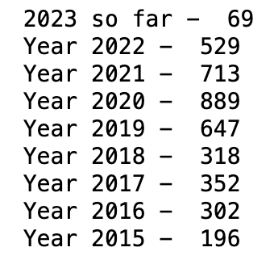
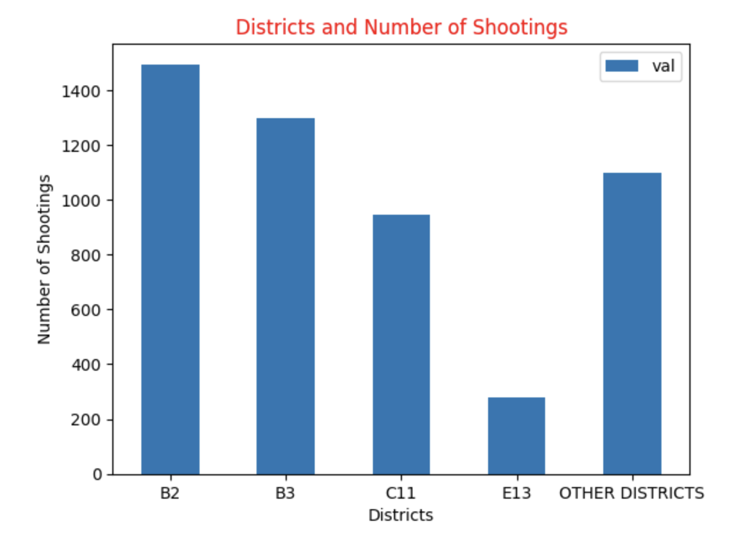
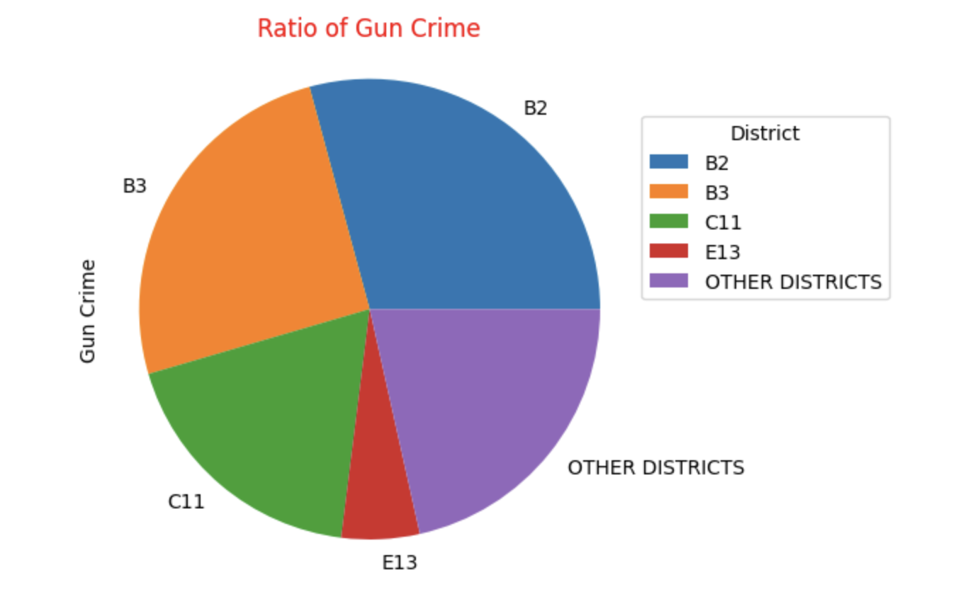
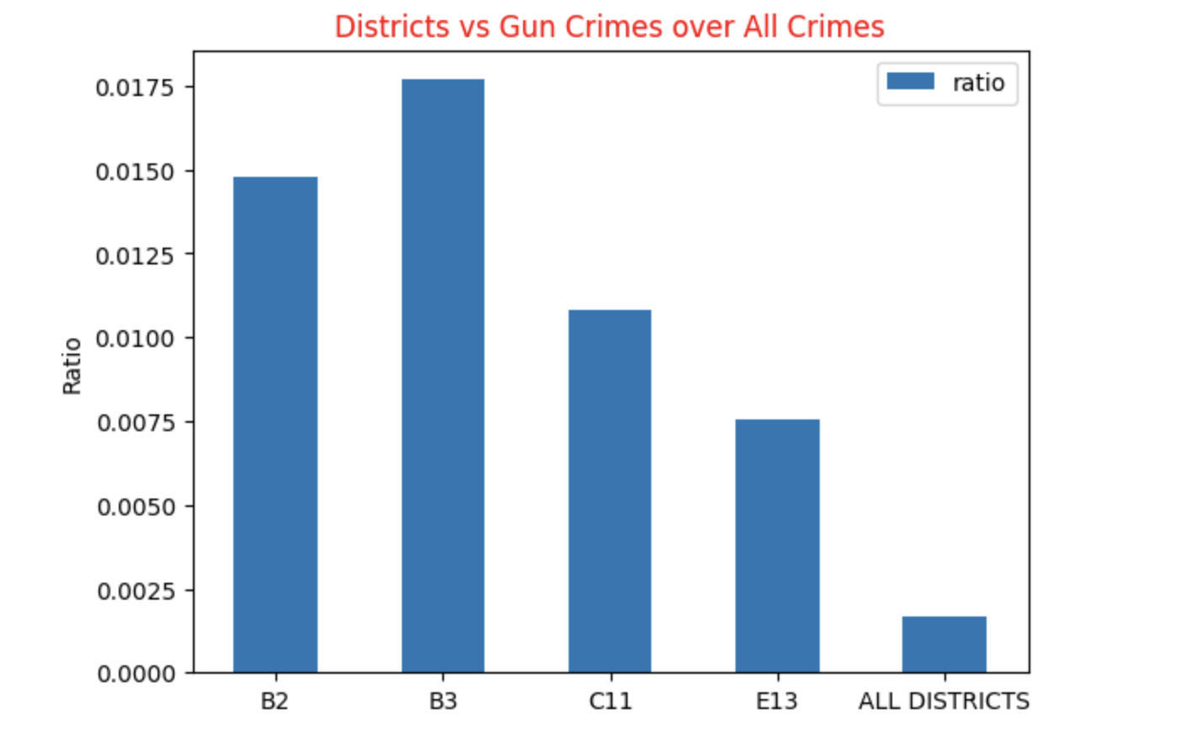
DECREASING TRENDS ON GUN CRIMES REPORTED
NUMBER OF GUN CRIMES REPORTED
Year-on-year growth rates:
From 2015 to 2016: 54.08%
From 2016 to 2017: 16.56%
From 2017 to 2018: -9.66%
From 2018 to 2019: 103.77%
From 2019 to 2020: 37.39%
From 2020 to 2021: -19.80%
From 2021 to 2022: -25.80%
Based on the above calculation, we can see that the year-on-year growth rate has been decreasing over the past few years. This suggests that the trend has been slowing down, and the numbers are not growing as quickly as they have in the past. However, as noted earlier, the latest observation for February 2023 is lower than the previous year's observation, suggesting a decrease in the trend.

Slide 5
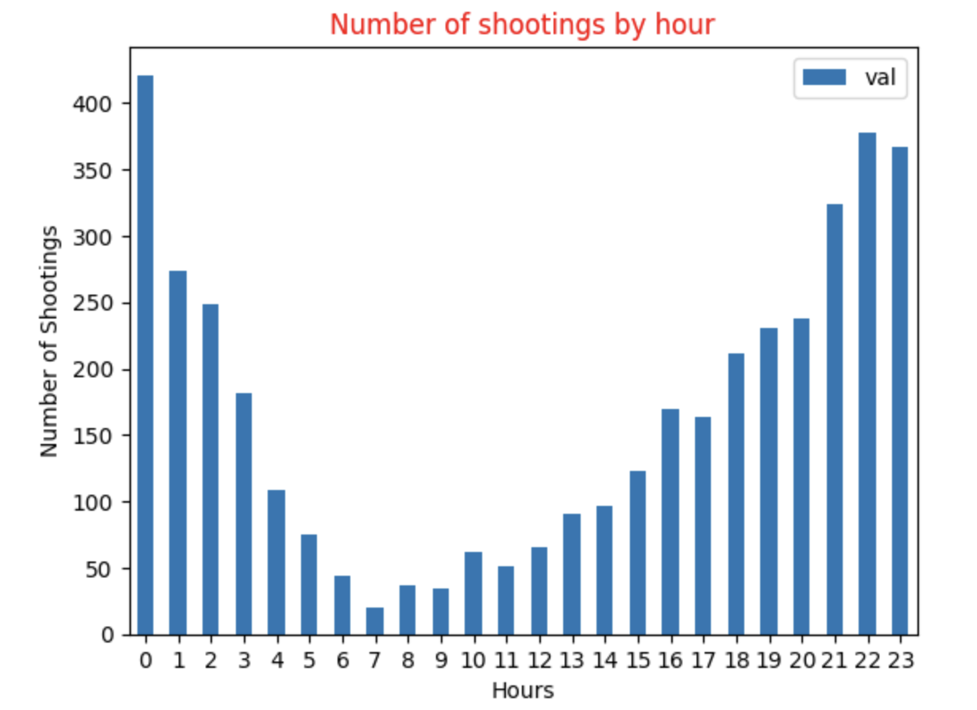
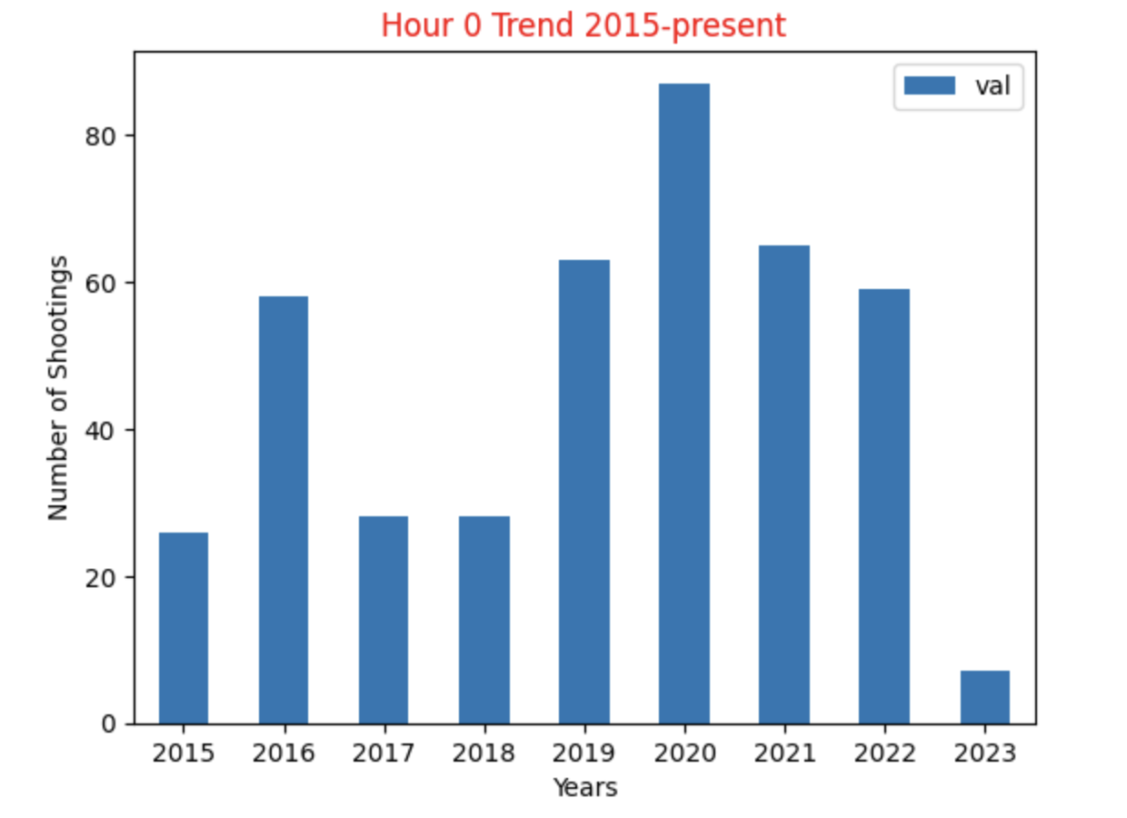
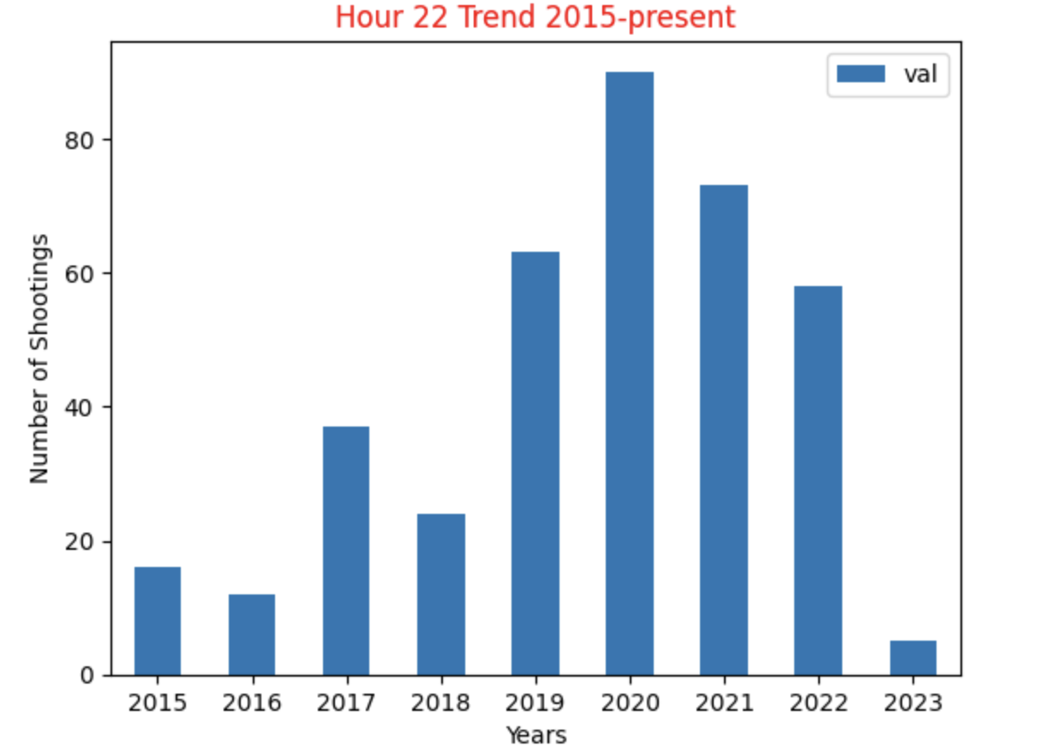
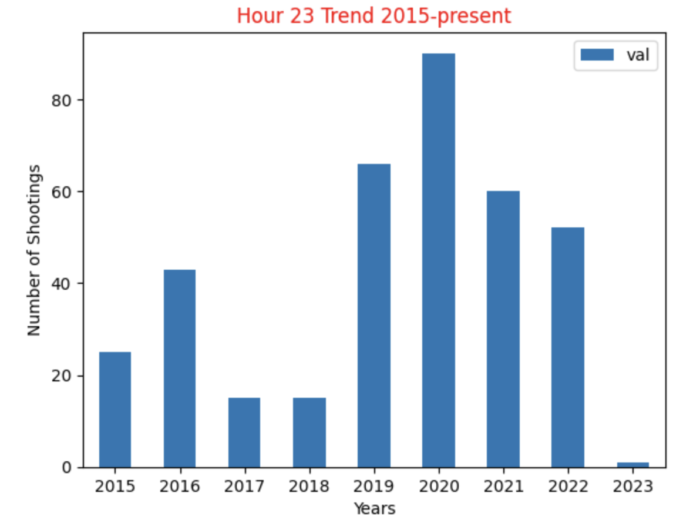
HOURLY TRENDS ON GUN CRIMES REPORTED
Based on the hourly data, We observe that Hour 22, 23 and 0 have the highest number of reports throughout the years and Below are the analysis of these hours.
We observe a decreasing trend in the reported crime incidents in those hours.

Slide 6
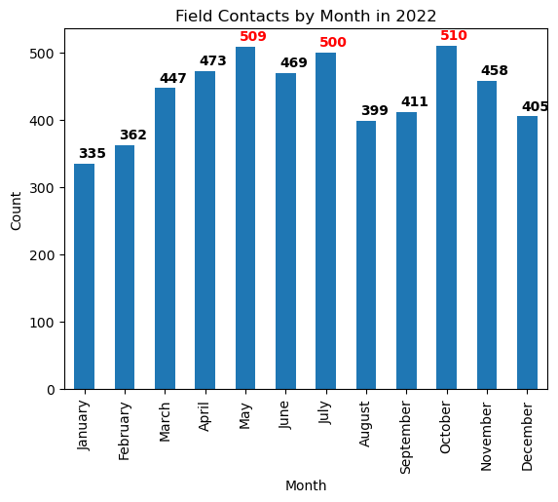
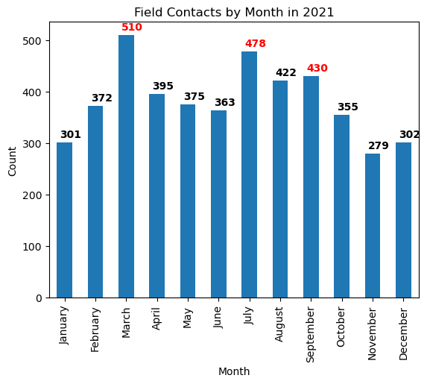
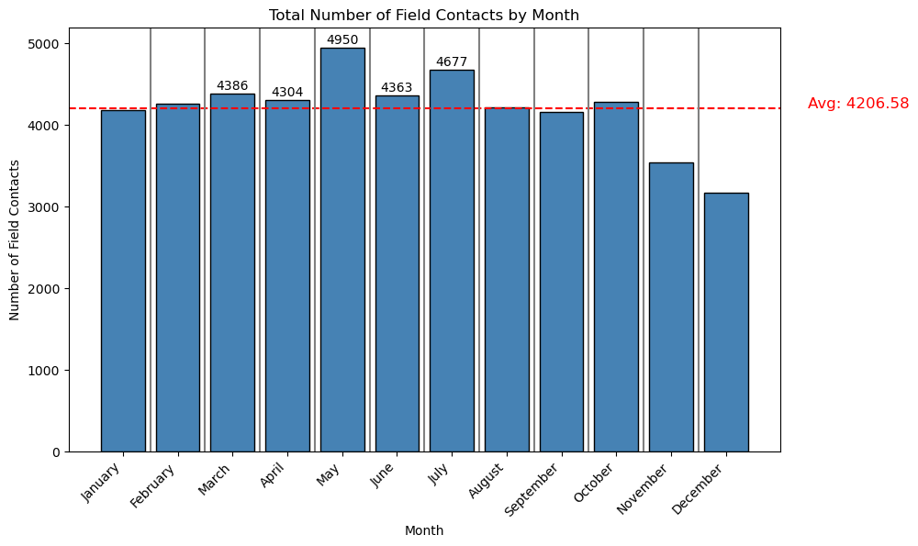
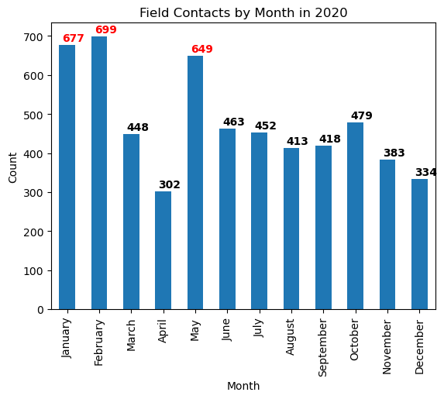
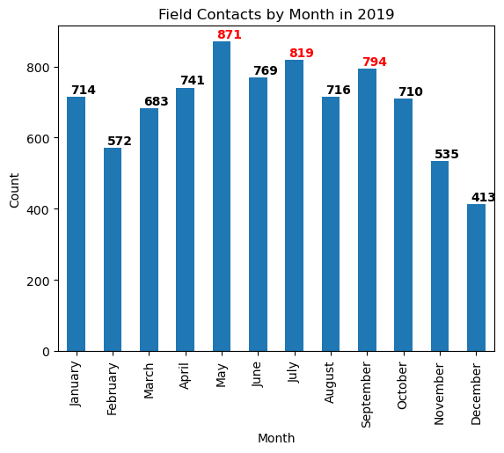
Monthly Field Contacts Data - 2016 / 2022
Field Contact Reasons:
Reasonable suspicion
911 Call
Top 5 months by count:
May (4950)
July (4677)
March (4386)
June (4363)
April (4304)
Notes:
C11 / B3 / E13

Slide 7
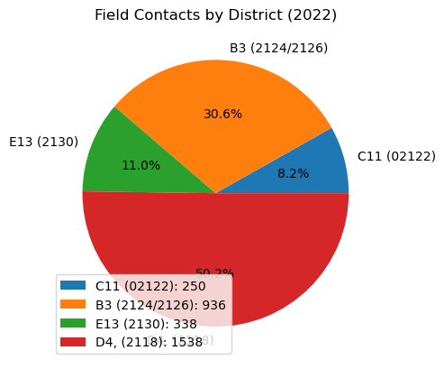
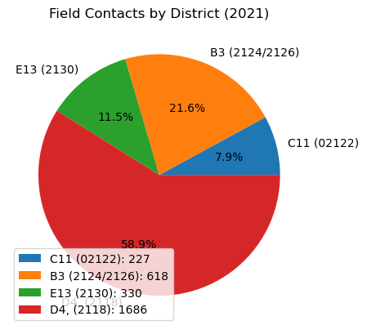
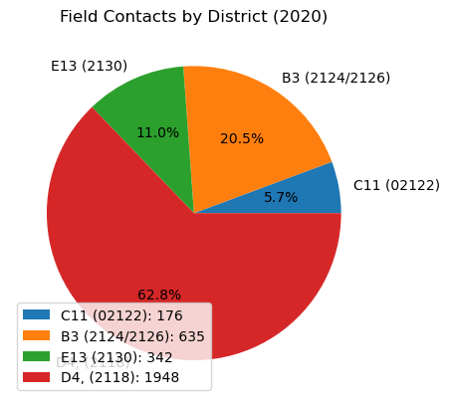
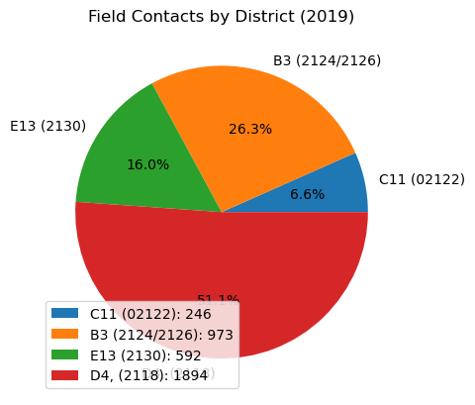
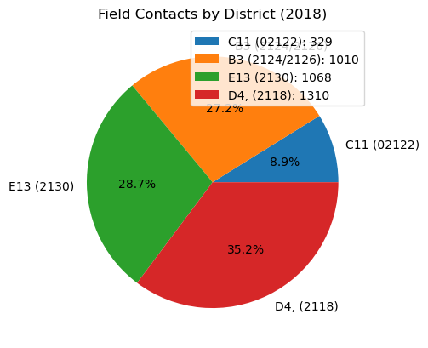
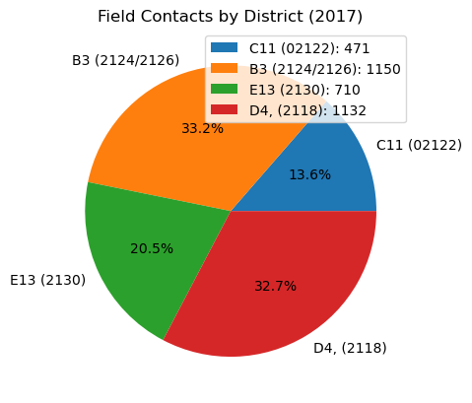
Field Contacts in Districts C11/B3/E13/D4 - 2017 / 2022
Districts Observed:
C11 (02122)
B3 (02124/02126)
E13 (02130)
D4 (02118)
Analysis:
Increase in field contacts in district D4 (~32%-~55%)
Decrease in field contacts in district E13 (~20%-~11%)
Notes:
C11 / B3 / E13

Slide 8
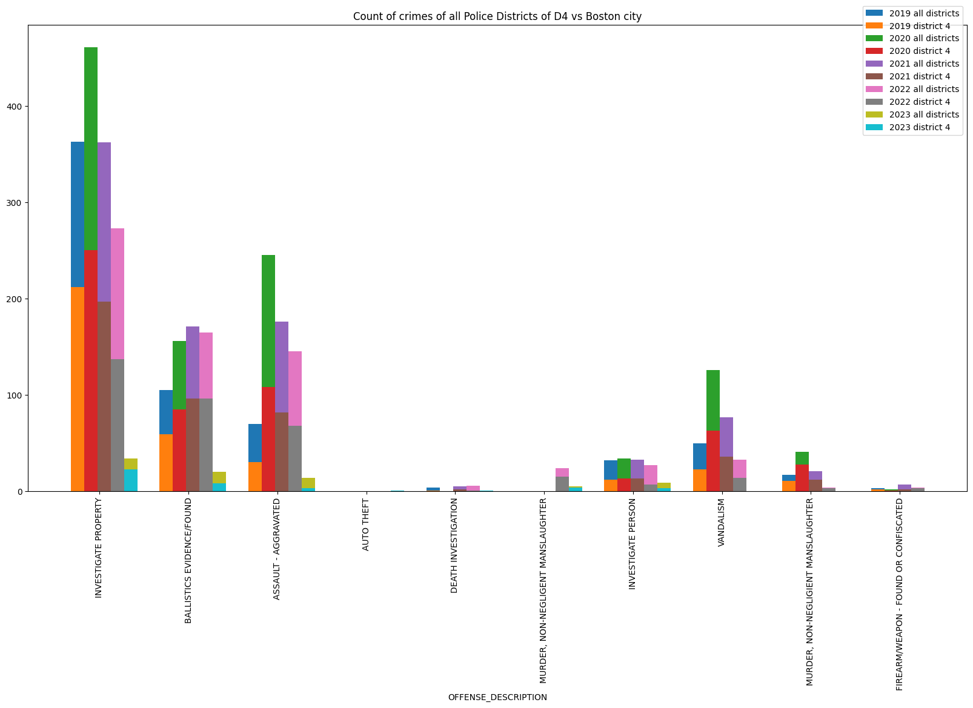
Patterns in terms of Type of violence involving shooting in the last 5 years
Key Points:
Overall, most crimes have consistently reduced after peaking in 2020.
However, Ballistics evidence showed an increase in 2021, making it the peak year for this type of crime.

Slide 9
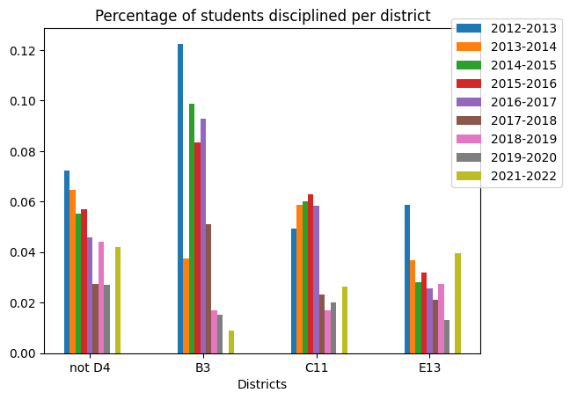
Student Discipline Data analyses
Key Points:
B3 School District had high disciplinary rates compared to other districts
This trend changed from the academic year 2018-2019
There has been a steady decrease in disciplinary rates from 2017-2022 in B3
C11's disciplinary rates have also been significantly smaller since 2016-2017

Slide 10
Exploring Further: A Deeper Look into
BPD FIO vs Shootings
Student Discipline on specific offenses
How does police presence effect crime (especially involving shooting) ?
Analysis of offenses related to gun violence for all districts. And what are the popular offenses?
BPD FIO vs Student Discipline
Is there a correlation between police and the number or kind of students offenses?

